Slide 1

INTERNSHIP on “Data Analysis on Titanic Survival Prediction using Machine Learning”
Jain College of Engineering, Belagavi, 590014
(Approved by AICTE, New Delhi & Affiliated to VTU, Belagavi)
Department of Computer Science and Engineering
(Accredited by NBA)
Name: Anurag Gundapi Prof. Nalinakshi B G
USN: 2JI20CS011 Internal Guide

Slide 2
INDEX
Sl. No. | Topic
1 | Objective of the Internship
2 | Company Profile
3 | Internship details
4 | Weekly Report
5 | Work/Task/Project Performed
6 | Skills Acquired/Tools & Techniques learned
7 | Internship impact
8 | Conclusion

Slide 3
OBJECTIVE OF INTERNSHIP
Gain practical experience in applying data science and artificial intelligence/machine learning (AI/ML) techniques to real-world problems.
Develop a deep understanding of data collection, cleaning, and preprocessing, as well as the application of AI/ML algorithms for analysis and prediction.
Learn how to work with large datasets, data visualization tools, and statistical analysis to extract valuable insights.
Acquire proficiency in programming languages such as Python and relevant libraries for data analysis and machine learning.
Collaborate with experienced data scientists and AI/ML professionals to solve complex challenges and contribute to ongoing projects.
Enhance problem-solving and critical thinking skills by tackling diverse data-related tasks and projects.

Slide 4
Company Profile
Cranes Varsity is a pioneer Technical Training institute turned EdTech Platform offering Technology educational services for over 25 years. A division of Cranes Software International Ltd, Cranes Varsity was established with an ambitious vision of bridging the gap between the technology academia and the industry. The team continuously strives to be an organization that brings together technology and education, empowering aspiring professionals to seek assured placements and a lucrative career path.Cranes Varsity offers high-impact hands-on technology training that catapults engineering students, graduates, and working professionals to be quickly employable in Niche high-end engineering fields. The in-house placement team further ensures that these students get placed in leading corporate firms – with whom Cranes Varsity has decades-old relationship. Cranes Varsity carries a legacy of being the Authorized-training partner for Texas Instruments, Math Works, Wind River & ARM. Cranes Varsity also has the honor of being a trusted partner of over 5000 reputed Academia, Corporate & Defence Organizations. Cranes Varsity has training leadership in EMBEDDED, MATLAB & DSP, extending training domains to emerging industry trends like Automotive, IoT, VLSI, Java full-stack, Data Science, Business Analytics and Software Programming.

Slide 5
Internship | From 11/08/2023 to 11/09/2023
Mode of Internship Online/Offline | OFFLINE
Student name | Anurag Gundapi |  | USN: 2JI20CS011
Semester | 7th Semester
Domain Name | Data Science with AIML
Name of the Internal Guide | Prof. Nalinakshi B G
Name of the External Guide | Mr. Hemesh Maniraju
Organization Name | Cranes Varsity Private Limated
Organization Address | # 82, Presidency Building, 3rd & 4th Floor, St Mark's Rd, Bengaluru, Karnataka 560001
Project Title | Data Analysis on Titanic Survival Prediction using Machine Learning
External Guide Mobile No | 9513386949 | Email ID: hemesh.muniraju@gmail.com

Slide 6
Weekly Report
Week 01:
Python Basics
Datatypes and Strings
Lists, Dictionaries, Tuples
Control flow Statements
Functions
Week 02
Numpy Libraries
Pandas Libraries
Data cleaning and Handling Missing Data
Creating Graphs using Matplotlib
Introduction to Machine Learning

Slide 7
Weekly Report
Week 03 :
Training Dataset
Introduction to Regression (Linear and Logistic Regression)
Decision Tree Classifiers
Support Vector Machine and KNN Classifier
Week 04 :
Implementation of Project
Presentation of Project

Slide 8
WORK PERFORMED
Introduction to Data Science:
Data science is a multidisciplinary field that employs techniques from statistics, computer science, and domain knowledge to extract valuable insights and knowledge from complex and large datasets. It involves collecting, cleaning, and analyzing data to uncover patterns, trends, and correlations. Data scientists use various tools and algorithms to build models, make predictions, and solve intricate problems. This field plays a vital role in organizational decision-making and strategy development.
Key Components of Data Science:
Data Collection
Data Cleaning
Data Analysis
Feature Engineering
Machine Learning
Data Visualization
Statistical Analysis

Slide 9
WORK PERFORMED
Introduction to Machine Learning :
Machine learning is a subset of artificial intelligence (AI) that focuses on developing algorithms and models that enable computers to learn and make predictions or decisions from data. Unlike traditional programming, where explicit rules are coded, machine learning algorithms allow systems to learn patterns and relationships from data, making them capable of handling complex tasks and adapting to new information.
Key Concepts of Machine Learning :
Supervised ML
Unsupervised ML
Testing and Traing Dataset
Feature Engineering
Model Evaluation

Slide 10
WORK PERFORMED
Pandas: The library helps to load the data frame in a 2D array format and has multiple functions to perform analysis tasks in one go.
Numpy: Numpy arrays are very fast and can perform large computations in a very short time.
Matplotlib: This library file is used to draw visualizations

Slide 11
PROJECT PERFORMED
In this project we will learn how can we build a Data Analysis on Titanic Survival predicting model by using Machine Learning. In this Project, we will gain access to two similar datasets that include passenger information like name, age, gender, socio-economic class, etc. One dataset is titled train.csv and the other is titled test.csv.
Train.csv will contain the details of a subset of the passengers on board (891 to be exact) and importantly, will reveal whether they survived or not, also known as the “ground truth”.
The test.csv dataset contains similar information but does not disclose the “ground truth” for each passenger. It’s our job to predict these outcomes.
These following Datasets have been used Passenger ID
Passenger Class, Name, Sex, Age, Number of passenger's siblings and spouses on board(SibSp), Number of passenger’s parents and children on board(Parch), Ticket, Fare, Cabin, City where passenger embarked

Slide 12
PROJECT PERFORMED
import numpy as np: This line imports Numpy library and gives it the alias “np”. Numpy is commonly used for numerical operations and working with arrays in python.
import pandas as pd: This line imports the pandas library and gives it alias “pd”. Pandas is used for data manipulation and analysis.
import matplotlib.pyplot as plt: This line imports the matplotlib library and gives it the alias “plt”. Used for creating various types of plots and visualizations.
import seaborn as sb: Seaborn is a data visualization library build on top of matplotlib, providing a highlevel interface for creating attractive and informative statistical graphics.

Slide 13
PROJECT PERFORMED
Data collection: Obtain a dataset containing information about the Titanic Dataset
Data processing: Check for missing values and handle them, clean and format data for consistency
Data visualization: Create informative plots and graphs to visualize the relationships and trends. This can include scatter plots, regression lines, and residual plots.
Model evaluation: Access the quality of the regression models using metrics
Visualization of Results: Create final data visualizations and plots to present your findings in a clear and accessible.

Slide 14
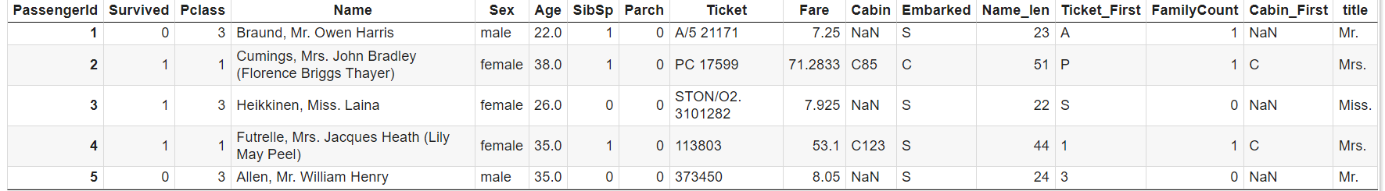
Results
Table of First few rows of Train Dataset :

Slide 15
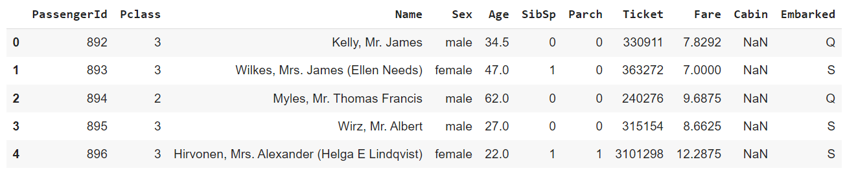
Results
Table of First few rows of Test Dataset :

Slide 16
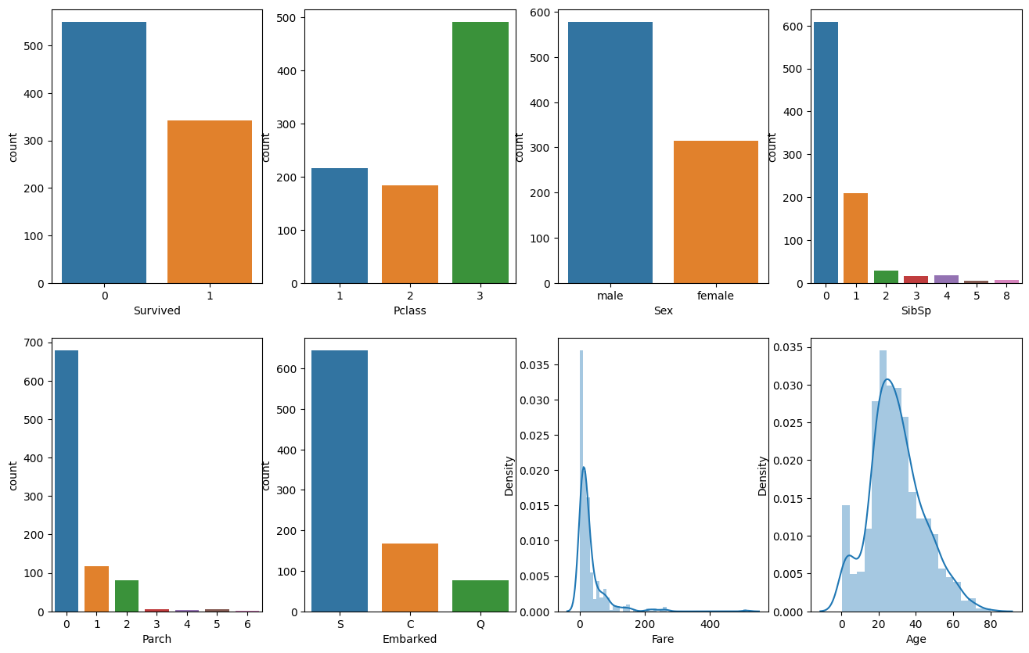
Results

Slide 17
Results
Matplotlib is a Python library for creating 2D and 3D plots and visualizations. It provides a wide range of tools for producing high-quality, publication-ready charts, graphs, and figures.
It supports various plot types, including line plots, scatter plots, bar plots, histograms, pie charts, heatmaps, and more

Slide 18
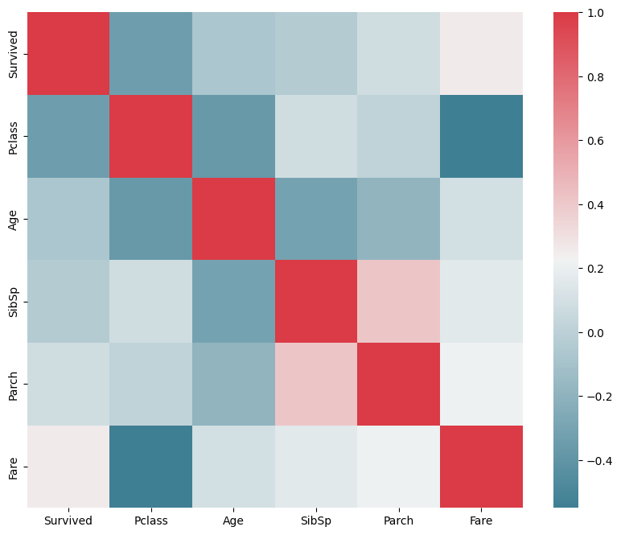
Results
Heatmap :

Slide 19
Results
Heatmap is a graphical representation that uses color to display data in a matrix-like format. It is often used to visualize and highlight patterns, correlations, or variations in data across two dimensions, typically rows and columns.
Heatmaps are primarily used to visualize two-dimensional data, making them ideal for displaying relationships between two sets of variables or categories.
Heatmaps use a color spectrum to represent data values.

Slide 20
SKILLS ACQUIRED & TOOLS USED
Understanding workplace culture.
Time management
Teamwork and collaboration
TOOLS USED: Google Colab
Google Colab is the cloud based platform provided by google for running python code in a collaborative and interactive environment. It offers several features.

Slide 21
INTERNSHIP IMPACT
Communication, teamwork, and time management skills are often honed during internships, it can boost your self – assurance, as you gain real – world experience and demonstrate your capabilities.
We can connect with professionals in the company, potentially leading to job opportunities or mentorship.
Internships allow us to apply classroom knowledge to real – world situations, enhancing your skills and understanding of your field.

Slide 22
CONCLUSION
Concluding my DS/ML internship has been a transformative journey. I've gained knowledge in machine learning algorithms, data analysis, and programming, as well as practical experience in real-world DS applications. Through projects and supportive mentors, I've honed my problem-solving skills and acquired the ability to work collaboratively. I'm equipped with a portfolio of impactful work, ready to showcase my capabilities to potential employers. I've also established valuable professional connections and absorbed essential ethical considerations. This internship has set a strong foundation for my DS/ML career, and I'm excited to continue my learning and contribute to the ever-evolving field.

